Slide 1

Identity and Access Management(IAM) Basics

Slide 2
Identity and Access Management(IAM) Basics
Identity and Access Management (IAM) is a core service you will use as a Solutions Architect.
IAM is what allows additional identities to be created within an AWS account.
  Identities which can be given restricted levels of access.
IAM identities start with no permissions on an AWS Account but can be granted permissions(almost) up to those held by the Account Root User.

Slide 3
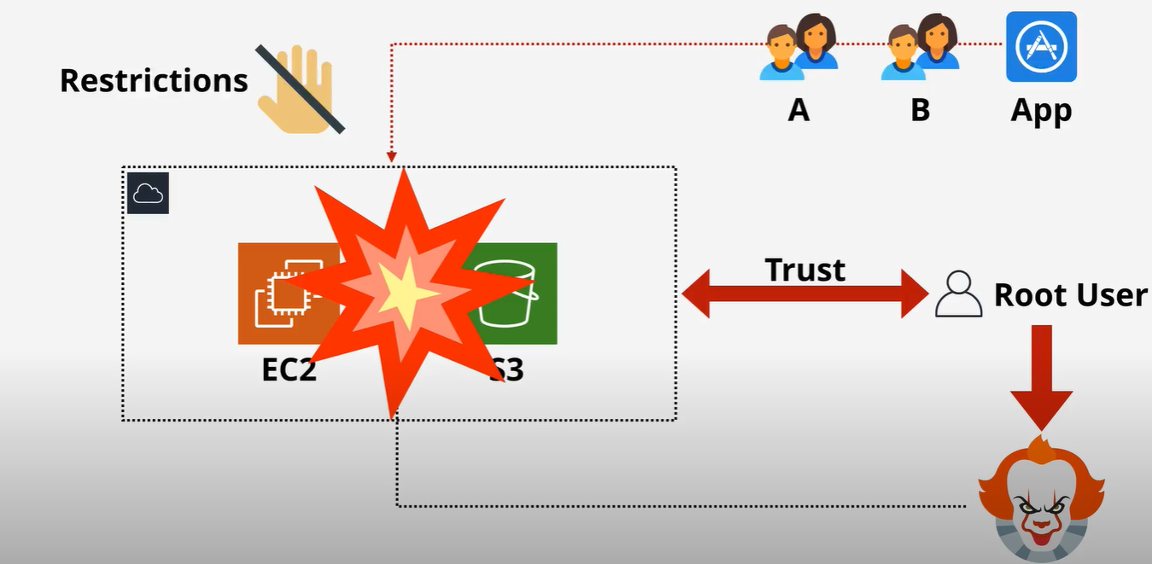
Identity and Access Management(IAM) Basics

Slide 4
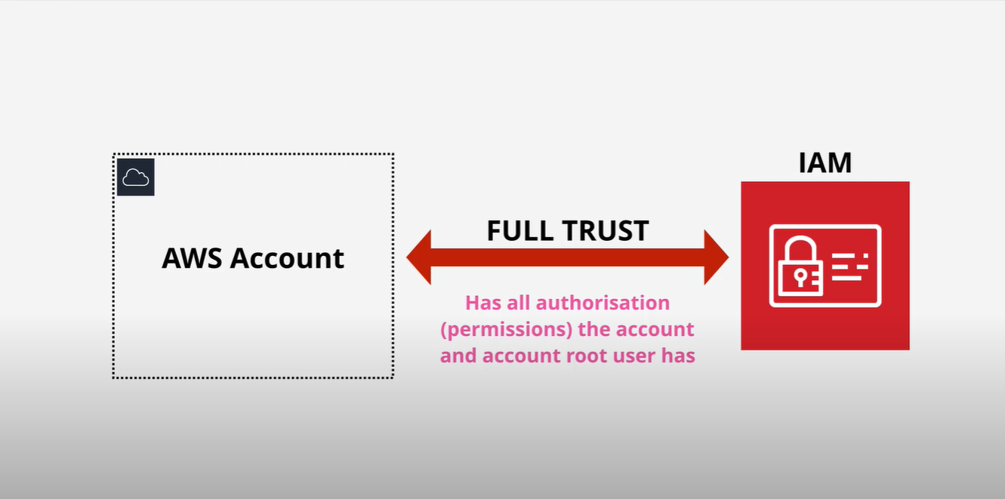
Identity and Access Management(IAM) Basics

Slide 5
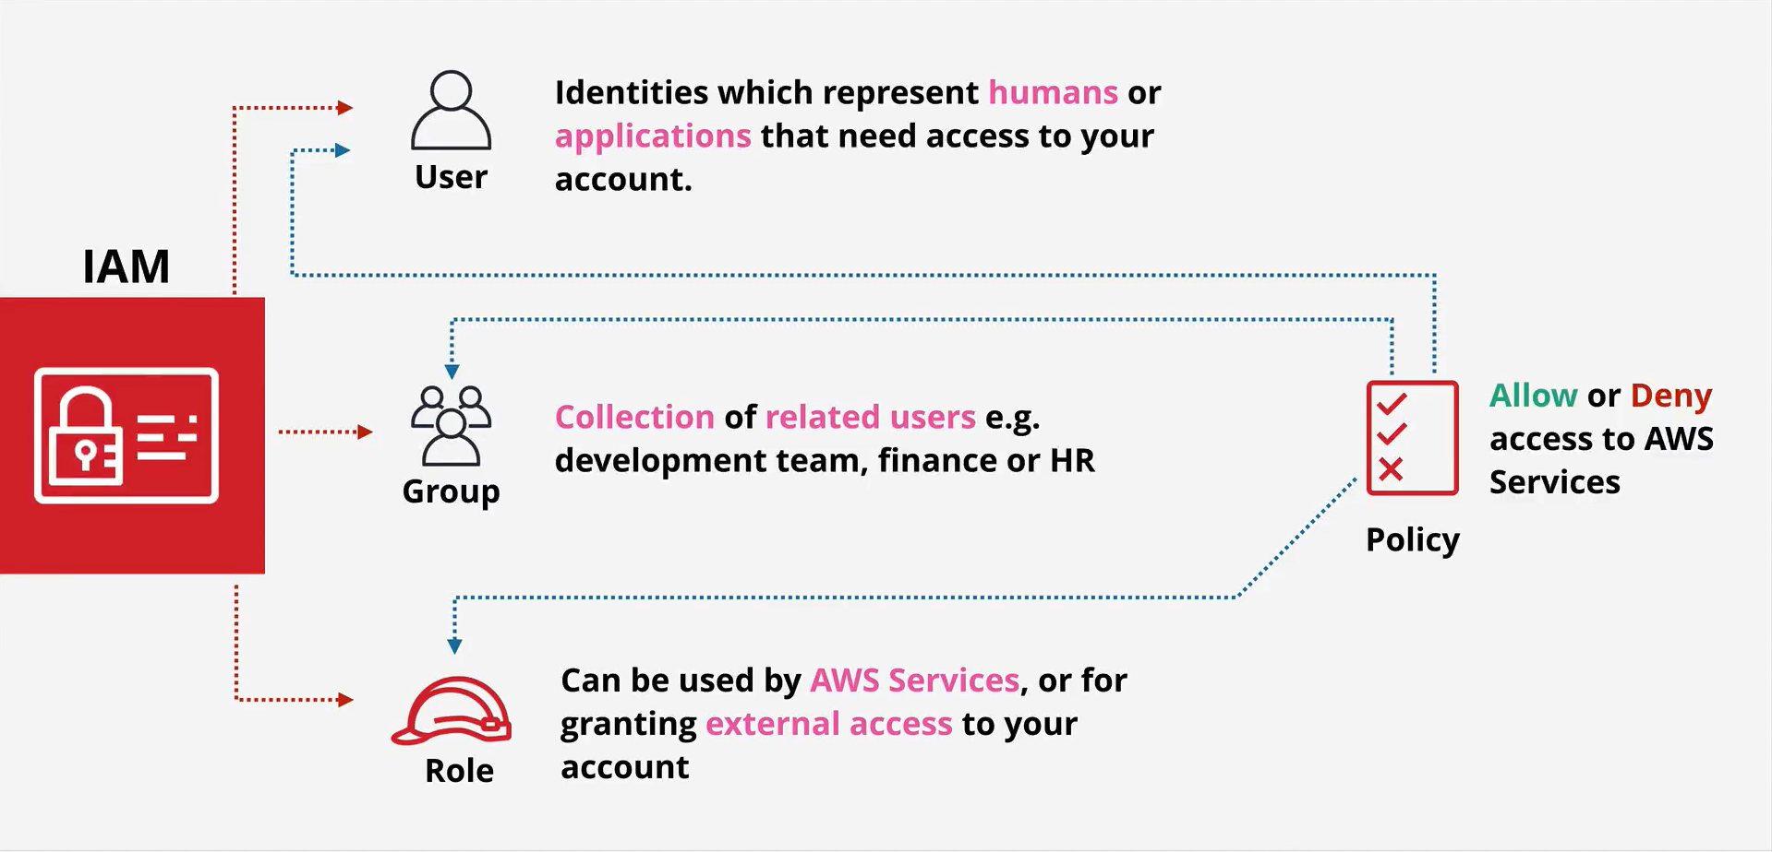
Identity and Access Management(IAM) Basics
IAM allows you to create three different types of Identities

Slide 6
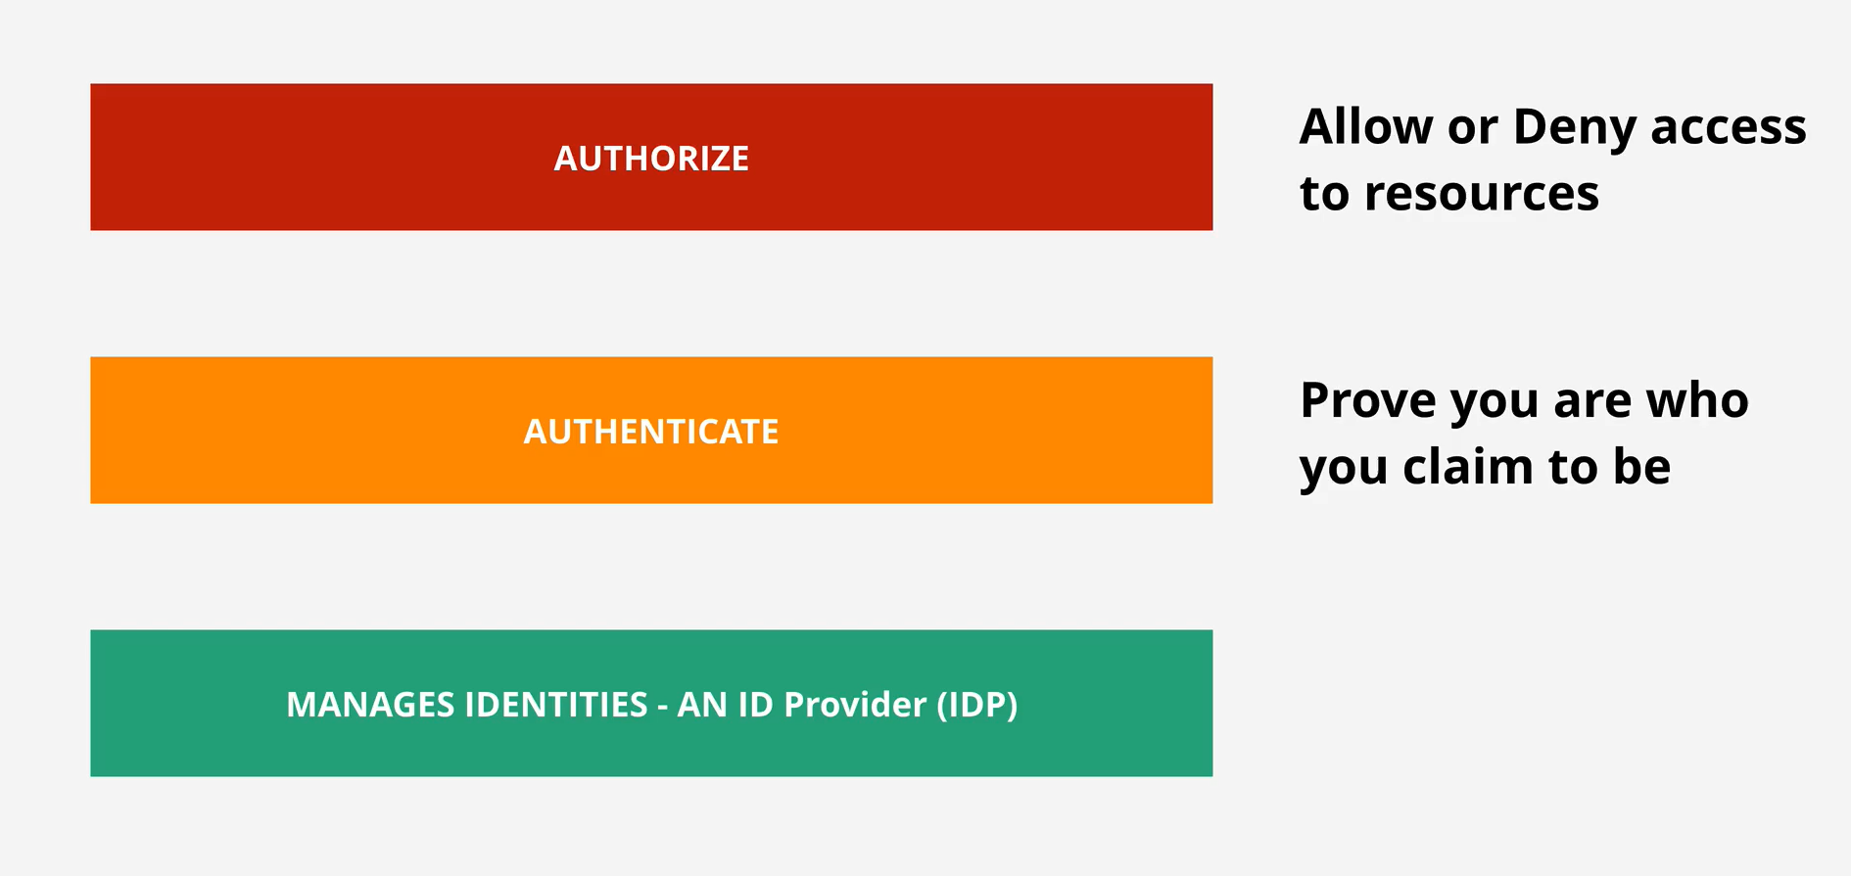
Identity and Access Management(IAM) Basics

Slide 7

Identity and Access Management(IAM) Basics
No cost
Global service /Global resilience
ALLOW or DENY its identities on its AWS account
No direct control on external accounts or users
Identity federation and MFA

Slide 8
IAM DEMO

Slide 9
Adding an IAM Admin – Development Account
In this lesson, I will step you through how to add an IAM user to the DEVELOPMENT AWS account which has permissions almost equal to the Account Root User
From this point onward in the course, we will use IAM identities to login and interact with the AWS Accounts.
We will use the Account Root User for emergency tasks only
MFA/OTP Applications
  1password.com
  authy.com
  https://apps.apple.com/au/app/google-authenticator/id388497605

Slide 10

IAM Access Keys

Slide 11
IAM Access Keys
Access keys are how the AWS Command Line Tools (CLI Tools) interact with AWS accounts
These are long-term credentials available within AWS.
There don’t change automatically or regularly.
The owner of the credentials must explicitly change them.

Slide 12
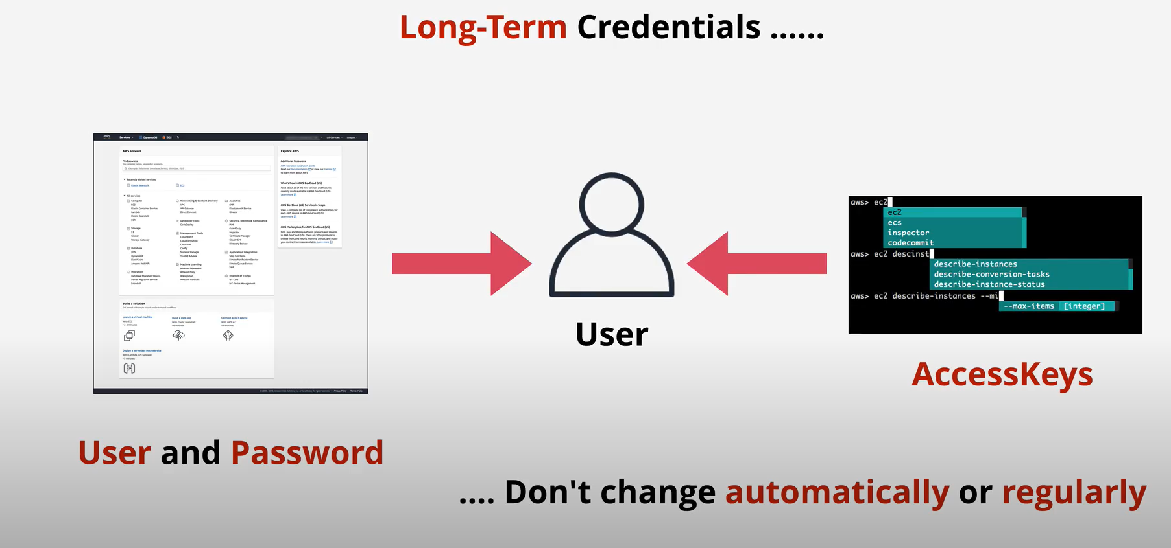
IAM Access Keys

Slide 13
IAM Access Keys
An IAM User has 1 username and 1 password
An IAM user can have two access keys
Access keys can be created, deleted, made inactive or made active

Slide 14
Access Keys
Access Keys are formed from two parts
Access Key ID AKIAXCZPH92BNPMGKKP2
Secret Access Key PS1xSKXpNGLNmywLf1i3DE0VeNx4eMsrRZrKH6+k
Rotate Access Keys by creating a new set and removing the old ones.
Except for the Account Root User, IAM users are the only identities that uses Access Keys.
IAM Users are the only identities that uses long term credentials.
IAM Roles don’t use Access Keys

Slide 15
Access Keys Demo

Slide 16
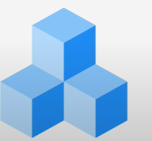
Public vs Private vs Hybrid vs Multi Cloud

Slide 17
Public vs Private vs Multi vs Hybrid
The term cloud computing spans a range of classifications, types, and architecture models.
Cloud computing can be categorized into three general types:
  Public cloud is cloud computing that’s delivered via the internet and shared across organizations.
  Private cloud is cloud computing that is dedicated solely to your organization.
  Hybrid cloud is any environment that uses both public and private clouds.

Slide 18
Public vs Private vs Multi vs Hybrid
Public Cloud = using 1 public cloud
Private Cloud = using on-premises *real* cloud
Multi-Cloud = using more than 1 public cloud
Hybrid Cloud = Public and Private Clouds
Hybrid Cloud is NOT public cloud + legacy on-premises

Slide 19
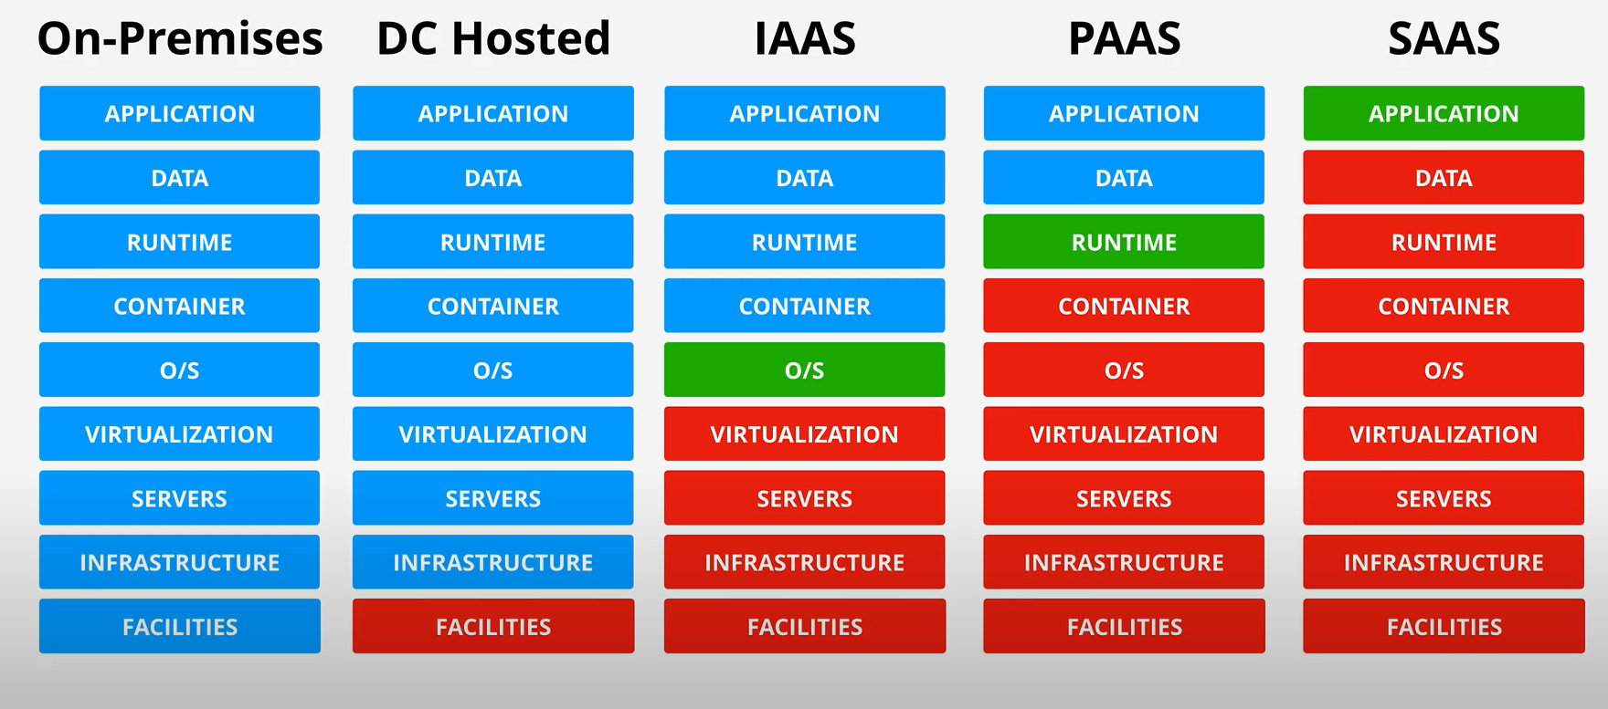
Cloud Service Model

Slide 20
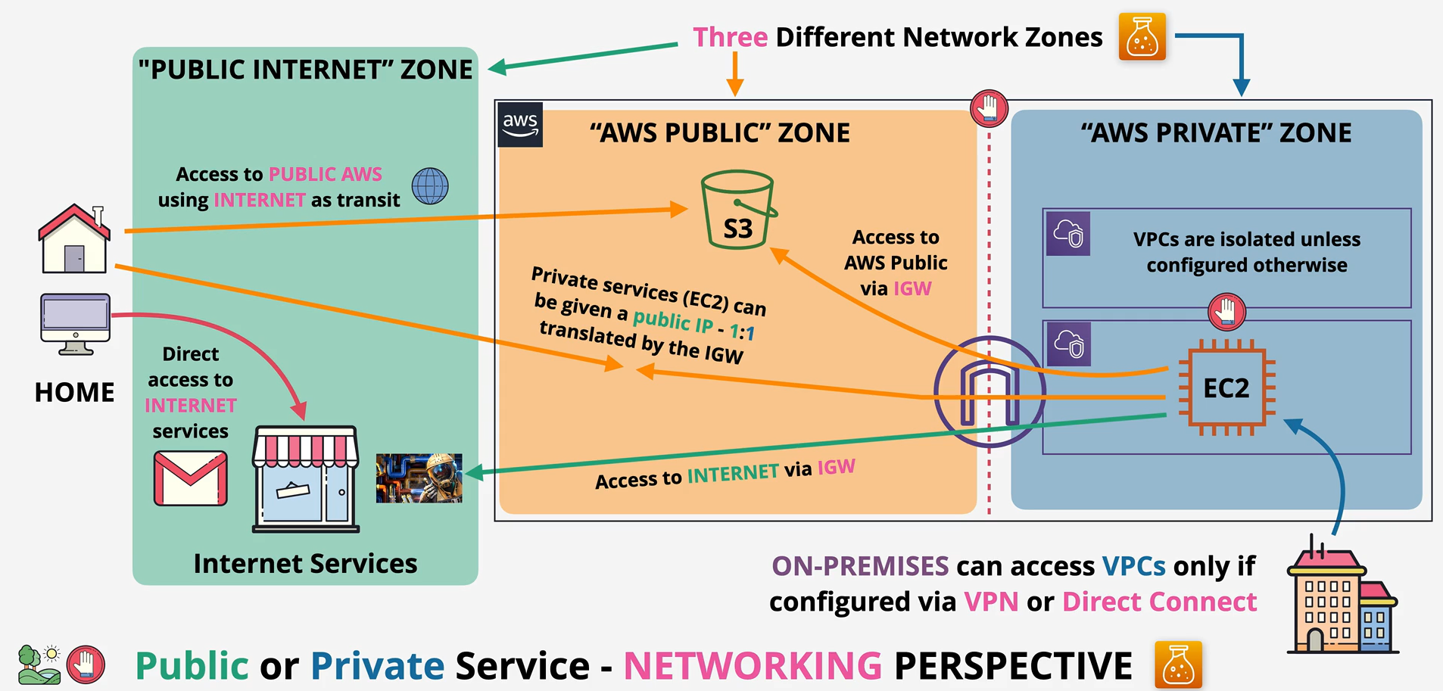
AWS Public vs Private Services

Slide 21

AWS Global Infrastructure

Slide 22
AWS Global Infrastructure
Even as a Solutions Architect, developer or SysOps engineer, a knowledge of architecture is critical.
AWS have created a global public cloud platform which consists of isolated ‘regions’ connected by high-speed global networking.

Slide 23
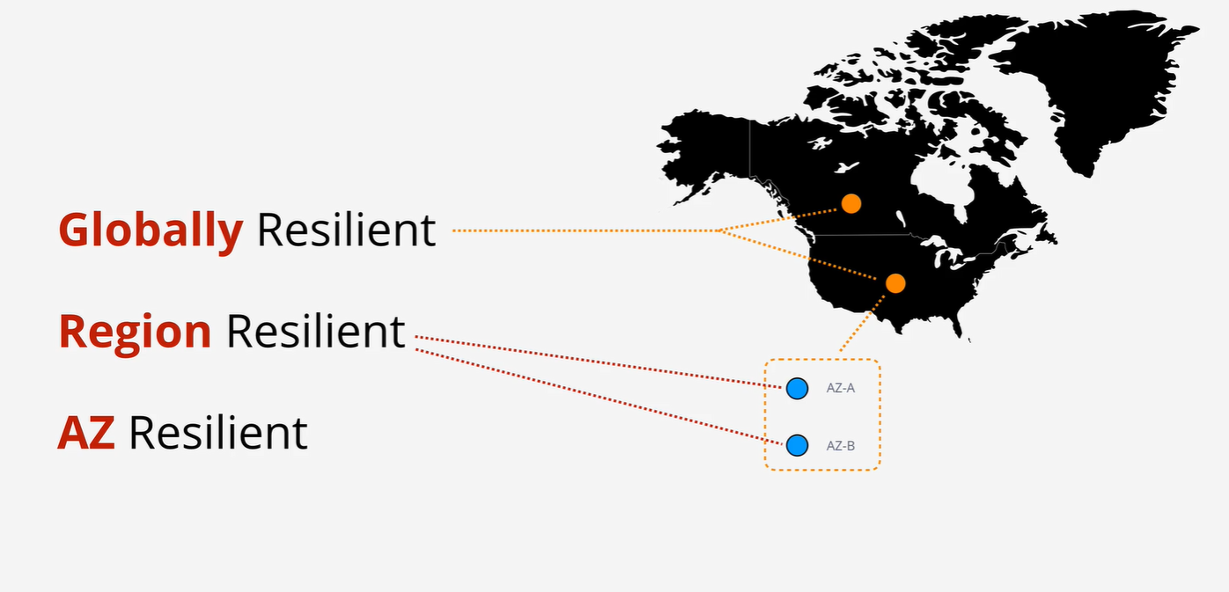
Service Resilience

